Slide 1



Phase-I Trigger Readout Electronics Upgrade for the ATLAS Liquid-Argon Calorimeters
TIPP17 – ? MAY 2017
Alessandra Camplani – Universita’ degli studi and INFN Milano
On behalf of the ATLAS Liquid Argon Calorimeter group

Slide 2
Outline
Introduction
LHC, ATLAS, LAr
Phase I Upgrade
LAr Front End Electronics
LAr Back End Electronics
Demonstrator
Summary

Slide 3
Introduction

Slide 4
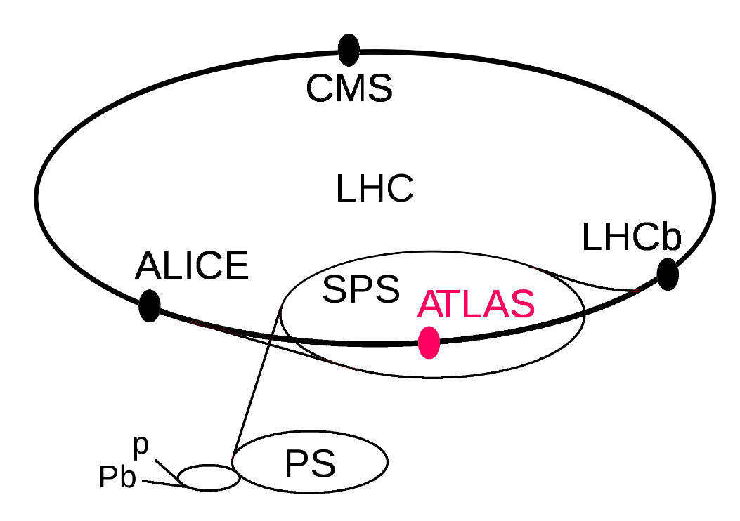
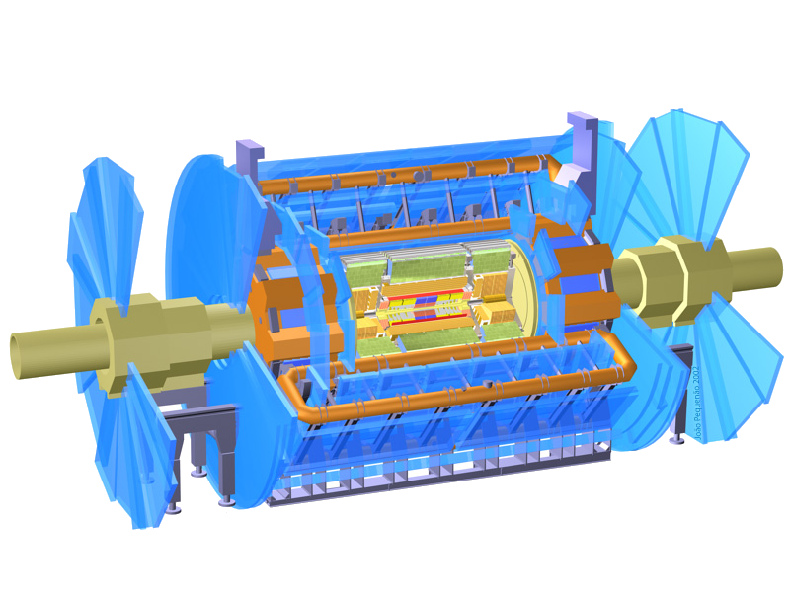
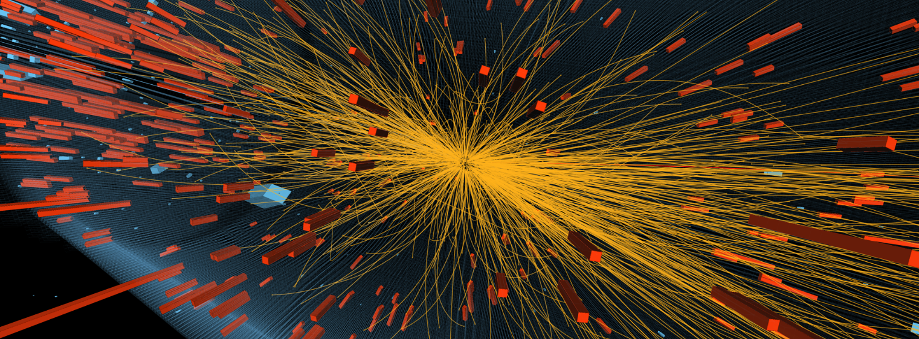
Context – LHC and ATLAS
Large Hadron Collider (LHC) at CERN, Geneva, Switzerland
27km circumference
depth between 50 to 175m
four collision points
ATLAS: A Toroidal LHC ApparatuS
46m long, 25m diameter and 7000 tons
Purpose:
Answer fundamental physics questions
Standard model

Slide 5
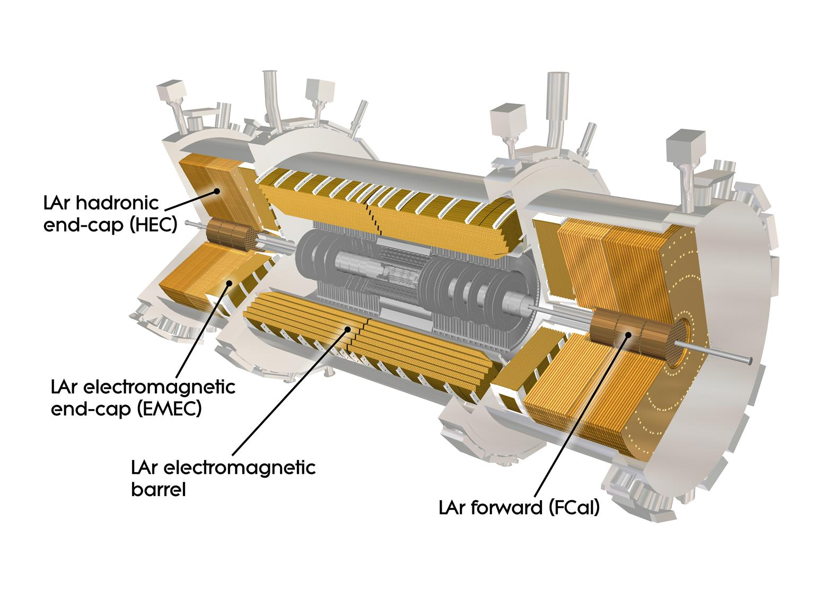
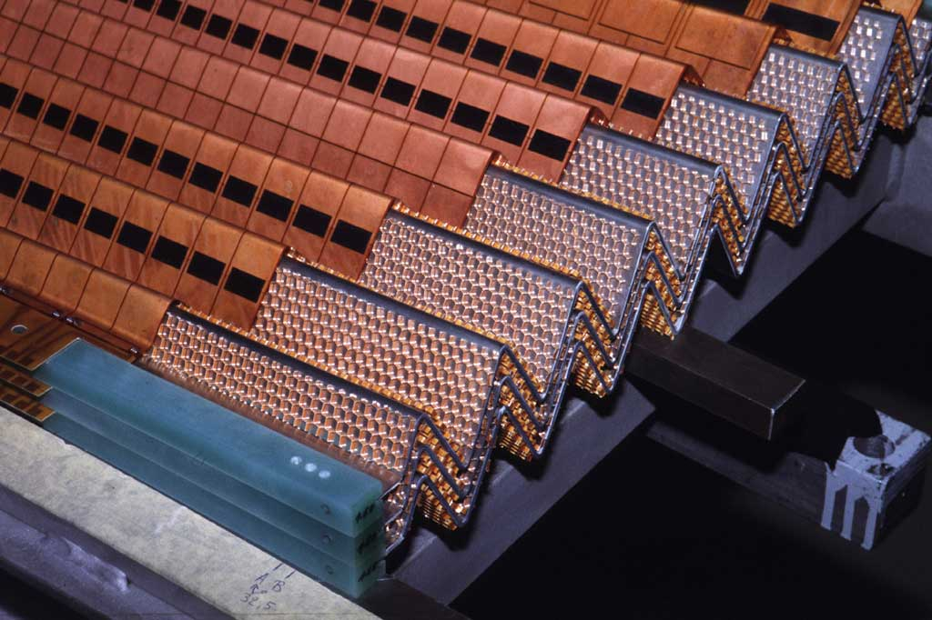
The Liquid Argon (LAr) Calorimeter
The LAr calorimeter is a sampling calorimeter with accordion-shaped lead absorbers and copper-kapton electrodes.
180K channels for the full readout of the electromagnetic (EMB+EMEC), hadronic (HEC) and Forward (Fcal) calorimeters
3K channels for analog Trigger readout
Front End crates: ≈ 1600 Front End Boards (FEB)
Back End crates: 200 Readout Out Driver boards (ROD)

Slide 6
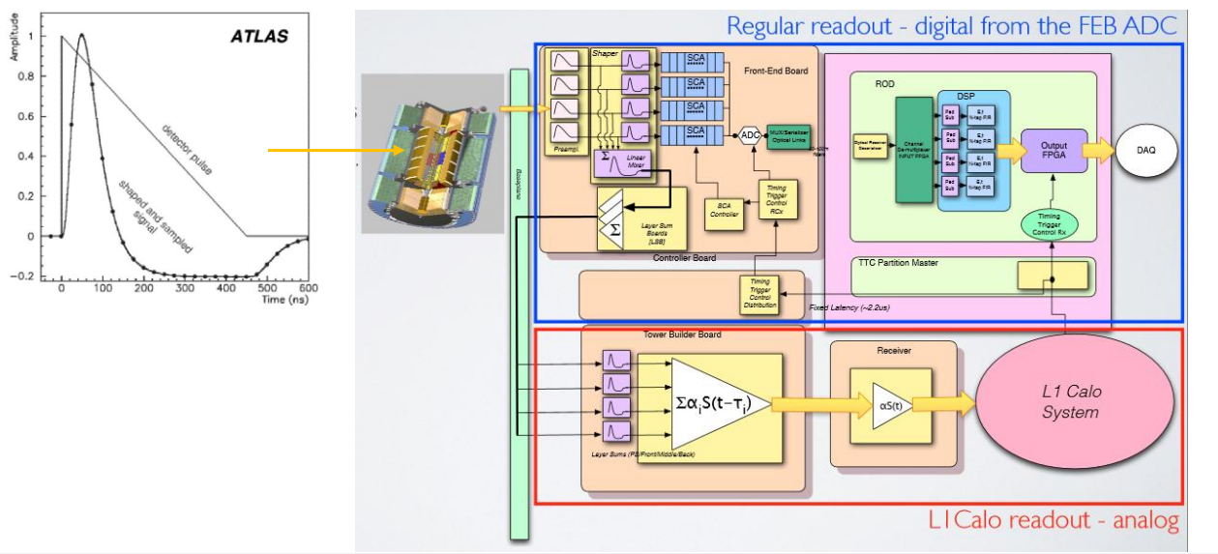
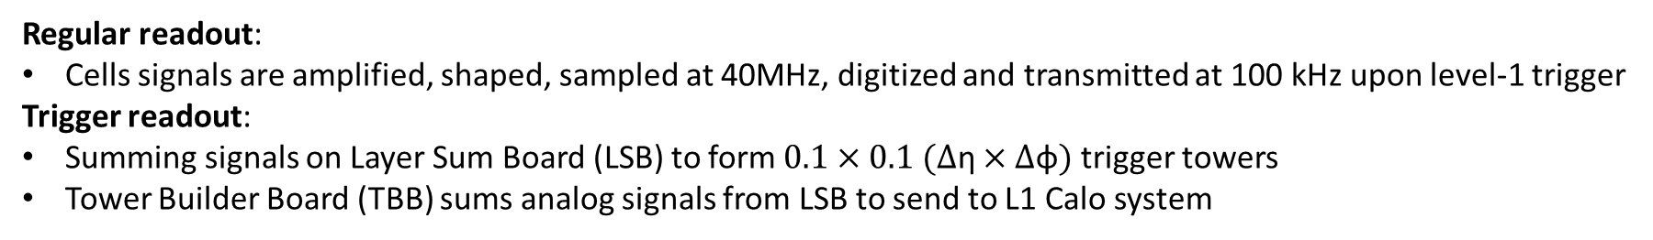
The current electronics
Regular readout:
Cells signals are amplified, shaped, sampled at 40MHz, digitized and transmitted at 100 kHz upon level-1 trigger
Trigger readout:
Summing signals on Layer Sum Board (LSB) to form $0.1×0.1 (∆\text{η}×∆\text{φ})$ trigger towers
Tower Builder Board (TBB) sums analog signals from LSB to send to L1 Calo system

Slide 7
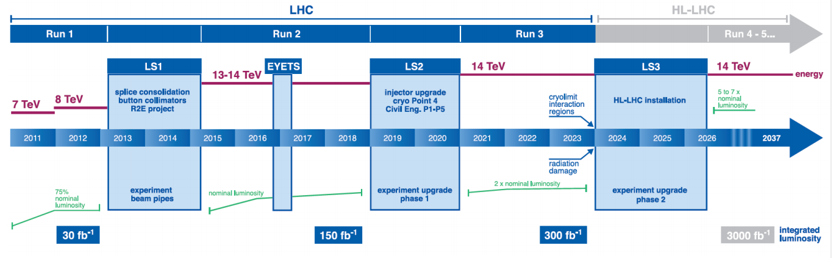
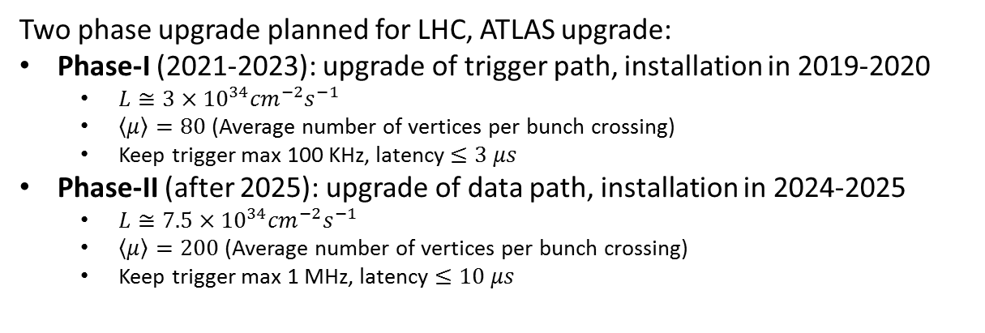
LHC Schedule
Two phase upgrade planned for LHC, ATLAS upgrade:
Phase-I (2021-2023): upgrade of trigger path, installation in 2019-2020
$L≅3×{10}^{34}{cm}^{−2}s^{−1}$
$\left\langle \left.μ\right\rangle \right.=80$ (Average number of vertices per bunch crossing)
Keep trigger max 100 KHz, latency $≤3 μs$
Phase-II (after 2025): upgrade of data path, installation in 2024-2025
$L≅7.5×{10}^{34}{cm}^{−2}s^{−1}$
$\left\langle \left.μ\right\rangle \right.=200$ (Average number of vertices per bunch crossing)
Keep trigger max 1 MHz, latency $≤10 μs$
Upgrade of LAr trigger readout
Upgrade of LAr main readout

Slide 8
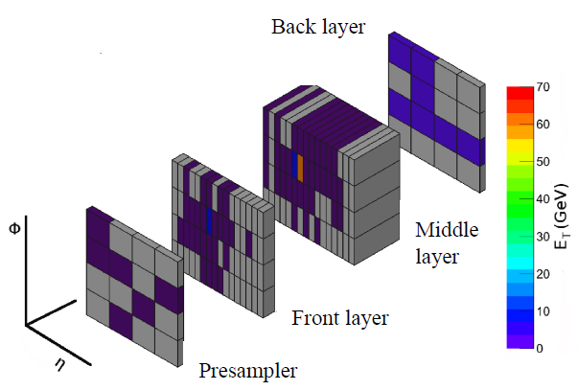
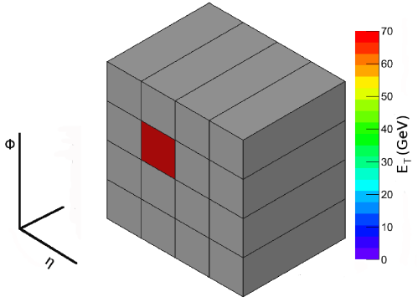
Calorimeter Upgrade
LAr Phase-I upgrade: new calorimeter trigger electronics with increased granularity and functionality for LAr calorimeter level 1 trigger
Trigger Tower
Super Cells
LAr Phase 1
Upgrade
Trigger Tower to Super Cells:
Granularity increased 10 times per each trigger tower
Provided information for each calorimeter layer for the full η range
Finer segmentation in the front and middle layers of the EM barrel and endcap
Higher resolution and shower information
Deal with the luminosity increase, maintaining a low-pT lepton threshold and keeping the same trigger bandwidth

Slide 9
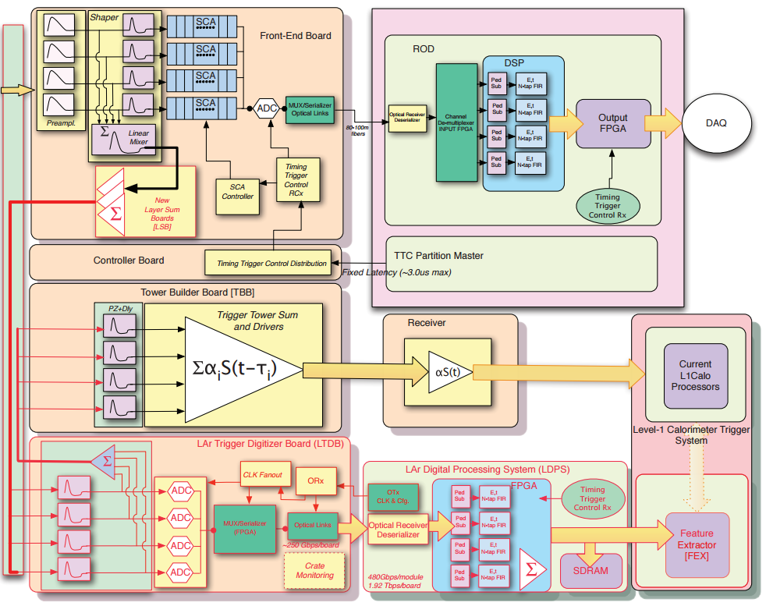
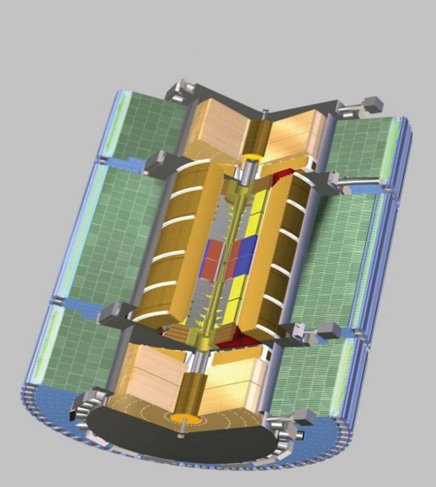
LAr Phase-I Project
Layer Sum Board
(LSB)
Baseplane
LAr Trigger Digitizer
Board (LTDB)
LAr Digital Processing System (LDPS)
New elements are highlighted in RED

Slide 10
Front-End (FE) Upgrade

Slide 11
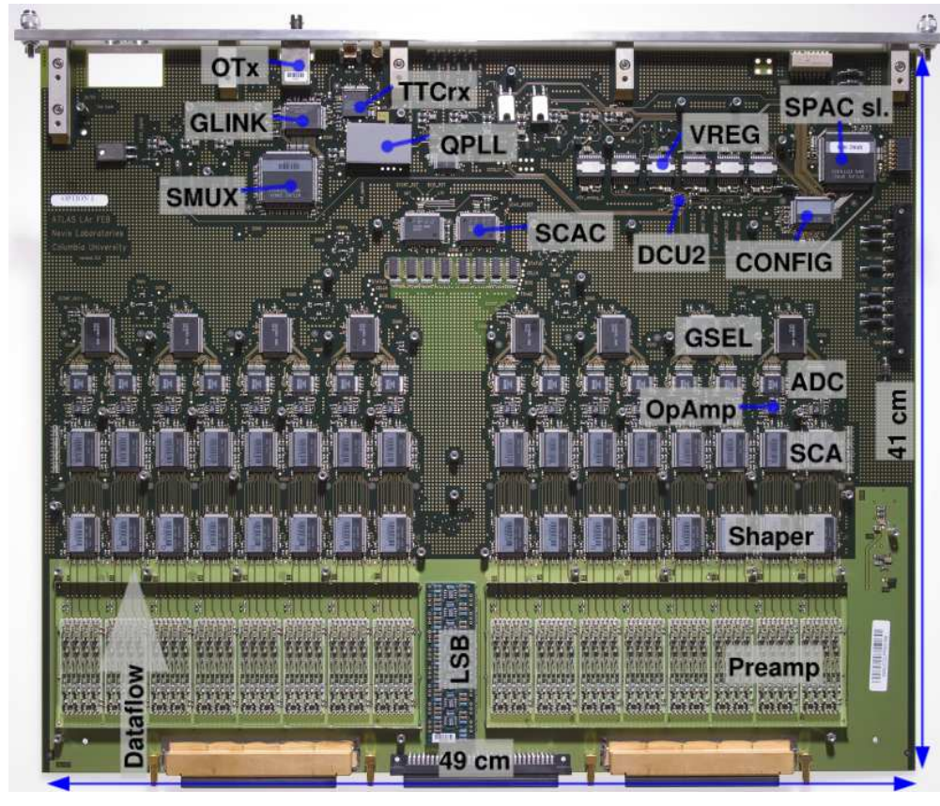
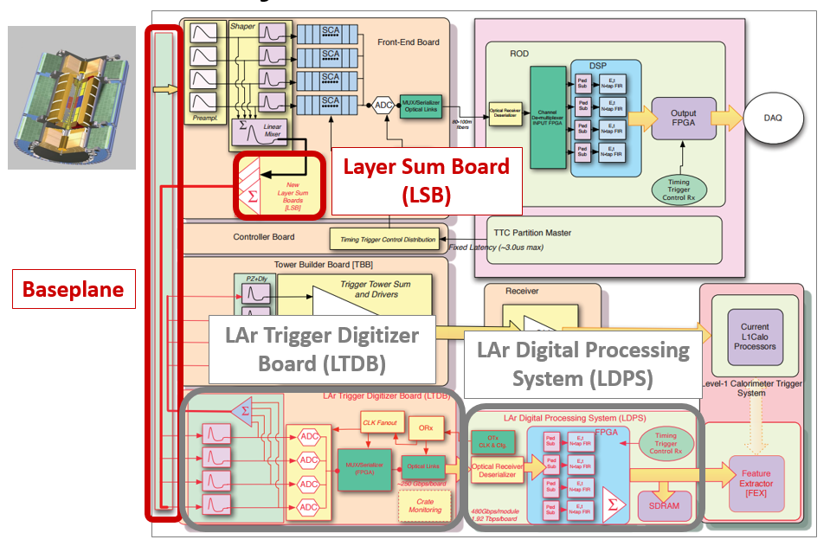
FE electronics components
FEB currently installed in USA15
New Layer Sum Boards (LSB) to perform analog sums for super cells
New Baseplane to keep compatibility with existing setup
LAr Trigger Digitizer Boards (LTDB) with radiation-tolerant custom ASICs
Nevis ADC
LOCx2
LOCld
Baseplane

Slide 12
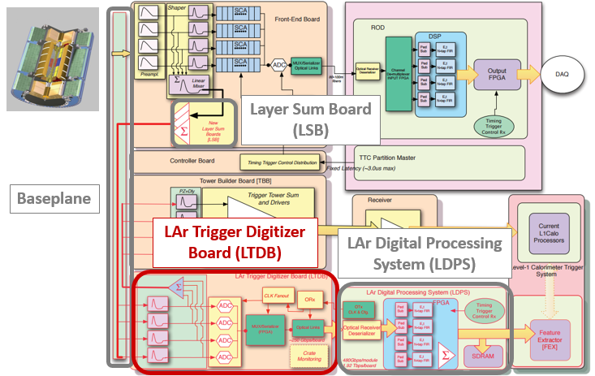
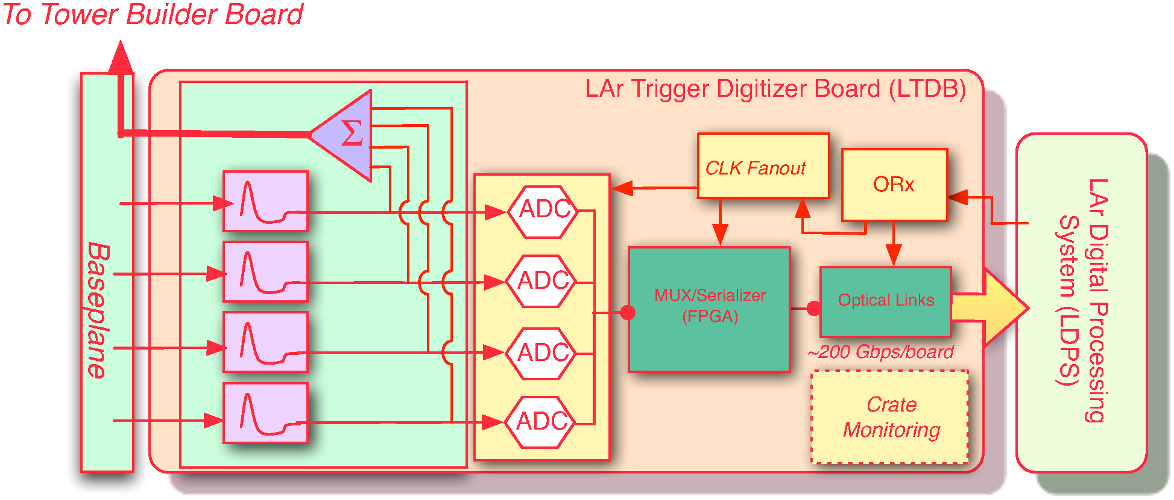
LAr Trigger Digitizer Board (LTDB)
124 LTDBs to readout the 34K Super Cells of the LAr calorimeter
1 LTDB handles analog input from 320 Super Cells
Digitizes all analog signals at 12 bits @ 40MHz using 80 custom ADC
Generate analog sums to keep compatibility with old system
Transmits digital signals using 40 optical links @ 5.12Gbps on custom ASIC
Receives TTC clock and data through 5 GBTx links
Design is made in collaboration between several groups
Phase-II compatible

Slide 13
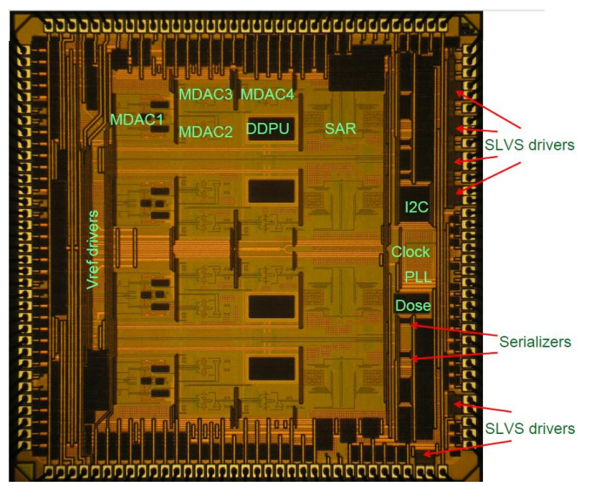
LTDB: NEVIS ADC
Quad 12 bits hybrid pipeline SAR ADC (IBM8RF 130nm CMOS)
40 MSPS
ENOB 11 bits
Dinamic range
Typically 11.8 bits
Power dissipation < 50 mW/channel
112.5 ns latency
Radiation tolerant
Die:
3.6 x 3.6 mm
72 pins QFN

Slide 14
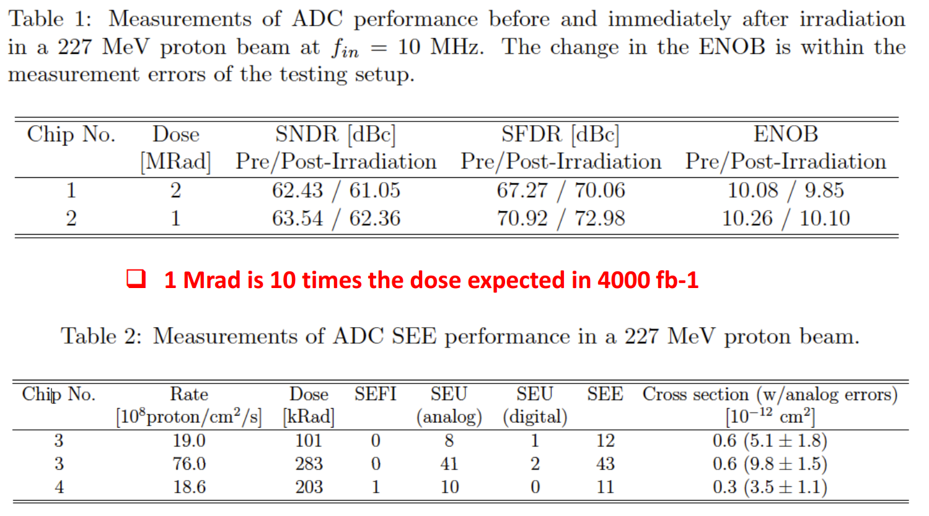
NEVIS ADC: radiation tolerance
Total Dose
Single Event Effect

Slide 15
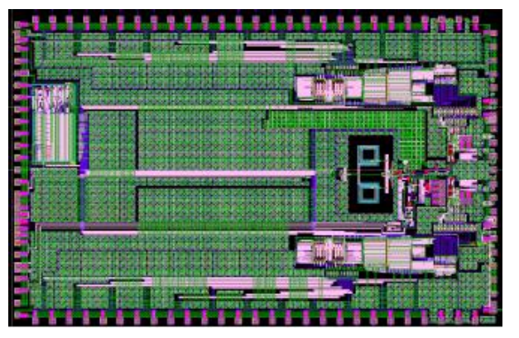
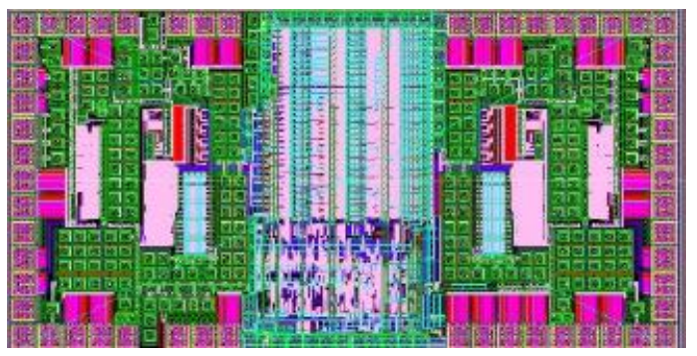
LTDB: LOCx2 & LOCld
Layout of the LOCx2 ASIC
LOCx2:
Silana Foundry 250 nm, Silicon-on-Sapphire
DUAL 8 x 14 bits serializer
5.12 Gbps outputs
Nevis ADC compatible
Radiation tolerant
LOCld:
Dual channel VCSEL driver
Radiation tolerant
Die:
2.114x1.090mm
40 pins QFN
Power consumption 1 W
Fixed Latency < 75 ns
Die:
6.036 x 3.68 mm
100 pins QFN
Layout of the LOCld

Slide 16
LOCx2 & LOCld: radiation tolerance
LOCx2
Eye Diagram 5.12 Gbps
2 Channels chip soldered on PCB
Total jitter ~ 50 ps (loop filter = 800 kHz)
Eye Diagram after 182 krad TID
Low or high dose rate (3krad/hr or 30 krad/h)
LOCld
No eye diagram change after 200 krad
2 channels shifted for display clarity
Current change after irradiation < 10%

Slide 17
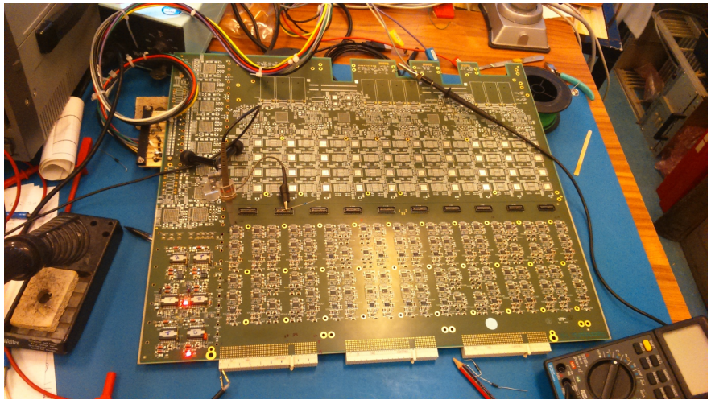
LTDB Development
LTDB pre-prototype 320ch
Pre-prototype PCB
FPGA used to replace LOCx2
LTDB prototype
Analog section and digital section are designed by different institutes, and Gerber merged for fabrication
Power section is realized on a mezzanine
2 LTDB prototypes could be used to replace LTDB demonstrators in January 2018

Slide 18
Back-End (BE) Upgrade

Slide 19
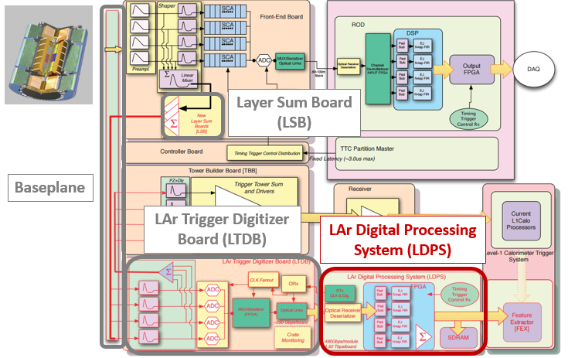
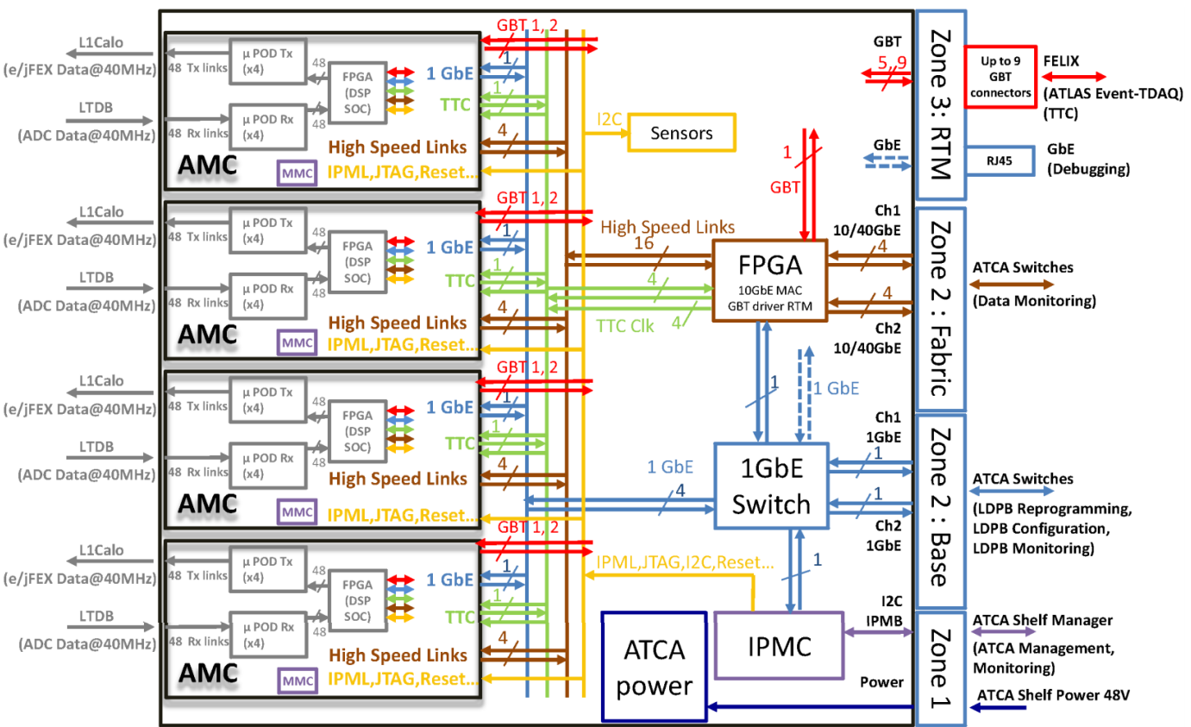
LAr Digital Processing Blade(LDPB)
Receives digital SC data from the LTDBs of the upgraded FE system, reconstructs E_{T}SC (the transverse energy of each SC), and transmits the results to the Level-1 Calorimeter Trigger System every 25 ns.
ATCA Carrier board
4 AMC mezzanine boards
192 input fibres @ 5.12 Gbps
192 output fibres @ 11.2 Gbps
Most recent FPGAs

Slide 20
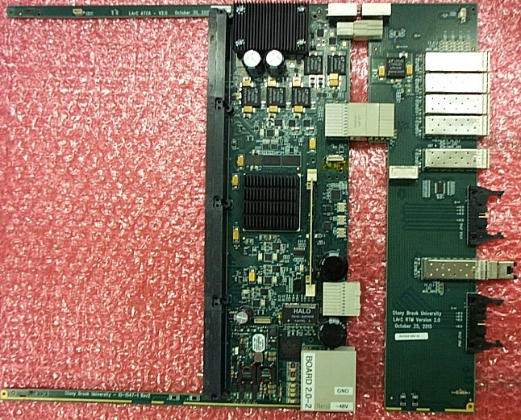
LDPB Carrier board
RTM board
Main board
22 layers PCB
GBT SFP+
DC/DC
DDR
Xilinx FPGA XC7VX550T FFG1927-2
AMC connectors
IPMC
GbE
Gbe Ethernet switch
BASE Ethernet and XAUI to backplane
48V control brick

Slide 21
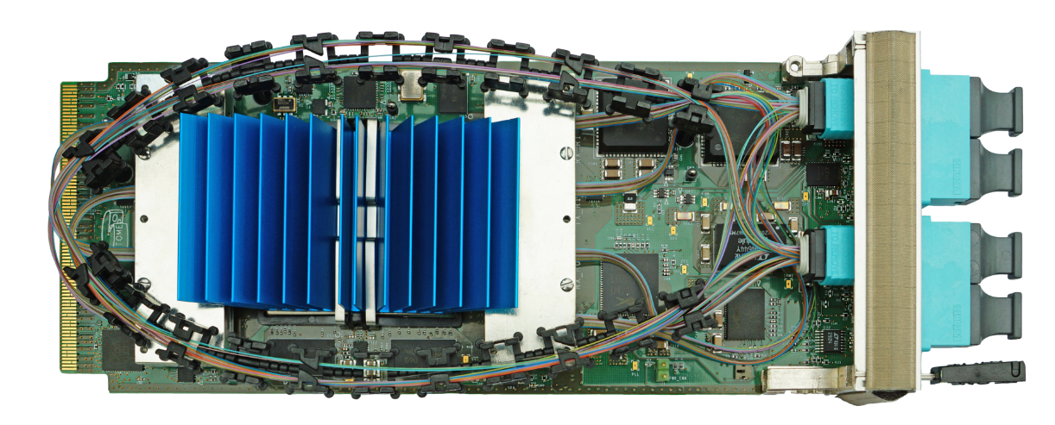
LAr Trigger prOcessing MEzzanine: LATOME
Main DATA path
Receives Super Cells DATA from LTDB @5.12 Gbps on up to 48 optical links
Computes Super Cells transverse energy (ET) using optimal filter
Builds trigger tower transverse energy
Sends trigger tower data @11.2 Gbps on up to 48 optical links
Sends Super Cell data to DAQ on L1A
Receives Timing Trigger & Control clock (TTC ) and data from the Carrier board
Monitors data and sends report to TDAQ system upon request on 10 GbE network
System has fixed latency less than 375 ns (15 BC)

Slide 22
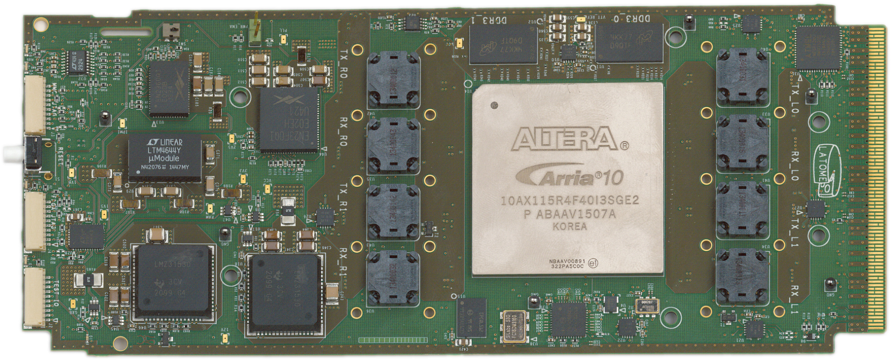
LATOME: Hardware
Altera Arria 10 FPGA (10AX115R4F40)
2Gbits DDR3 @ 800MHz
DC/DC block
MMC controller
AMC interface
16 layers PCB
8 Avago uPods (8*12 optical links)

Slide 23
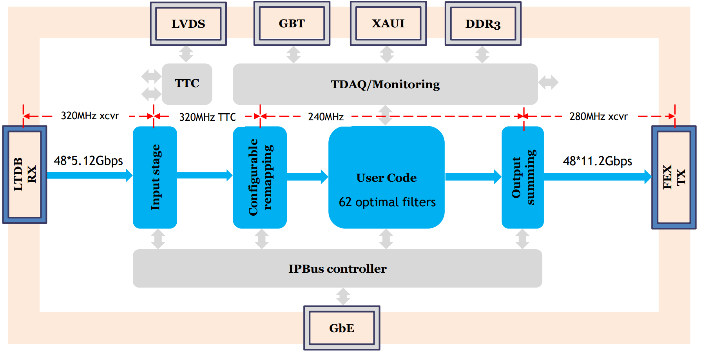
LATOME Firmware
Input stage aligns all inputs to the same BCID
Configurable remapping: reorders input data according to detector’s topology
User Code: computes Et and time using Finite Impulse Response filter (FIR)
Output summing: builds trigger tower energies

Slide 24
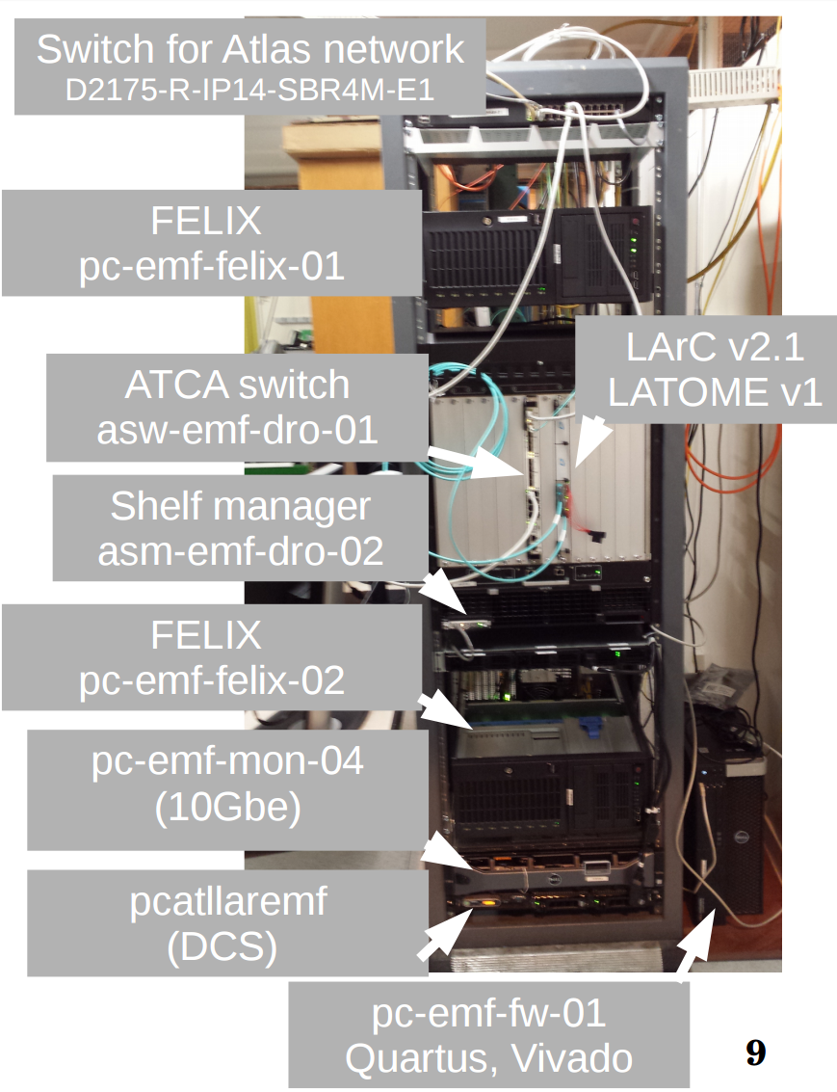
Back End System Test
Connect to the real environment @CERN
TTC
ATLAS Network
Development PCs
First system test done in march 2017
Checks simple configuration
More system tests in Q2 2017
Until fully functional
Production Readines Review
Carrier boards and LATOMEs in 2017

Slide 25
Demonstrator

Slide 26
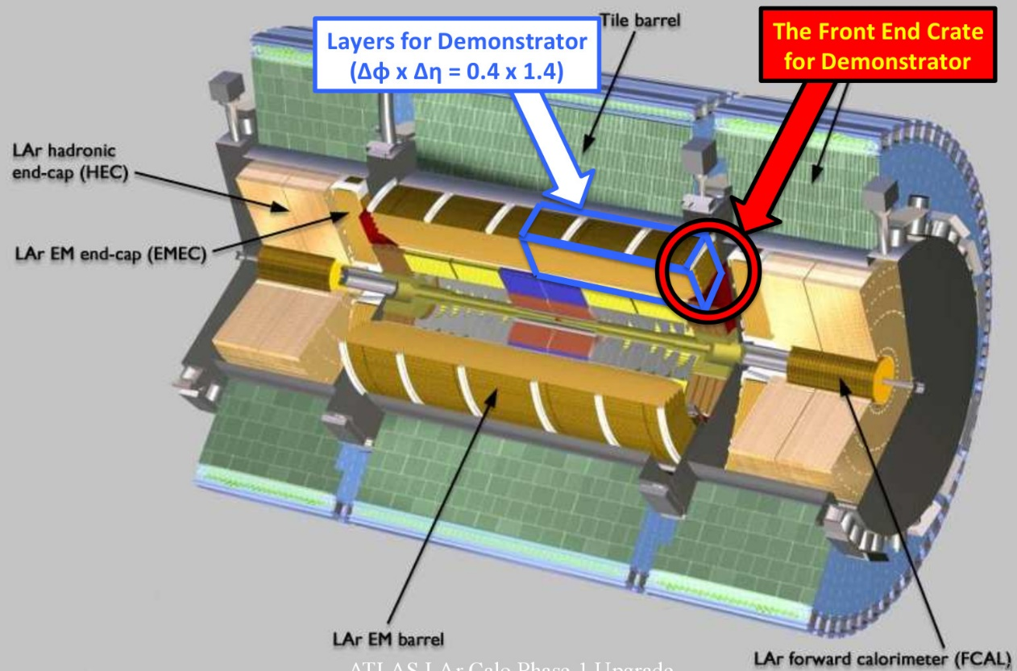
Demonstrator motivations
Reads data from Super Cells
Validates Energy reconstruction and bunch crossing identification
Measures trigger efficiency and jet background rejection
Gain experience in installation and operation of such equipment in the ATLAS environment

Slide 27
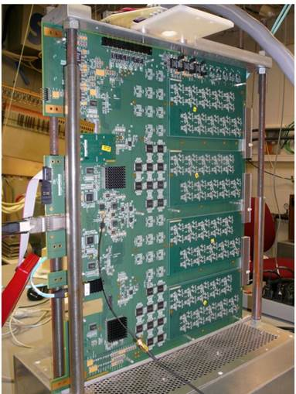
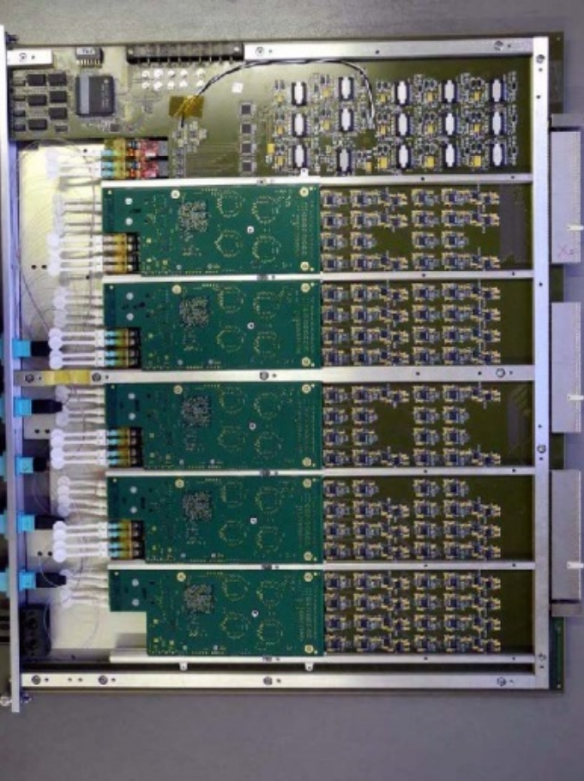
FE Demonstrator: LTDB
Digital MB + analog mezzanines
Handles up to 320 Super Cells signals
284 Super Cells in EM Barrel
Super Cells signals are digitized with 12bits ADC@ 40MHz
Commercial ADC COTS : TI ADS5272 (not radiation tolerant)
Multiplexing of 8 Super Cells on one 4.8Gbps optical link
8B10B encoding, K code sent every Bunch Crossing
FPGA (XILINX/ALTERA)
40 optical links
Throughput ≈200Gbps/LTDB
Status:
2 LTDBs installed in August 2014
Taking collision data in LHC Run 2
Analog MB + digital mezzanines

Slide 28
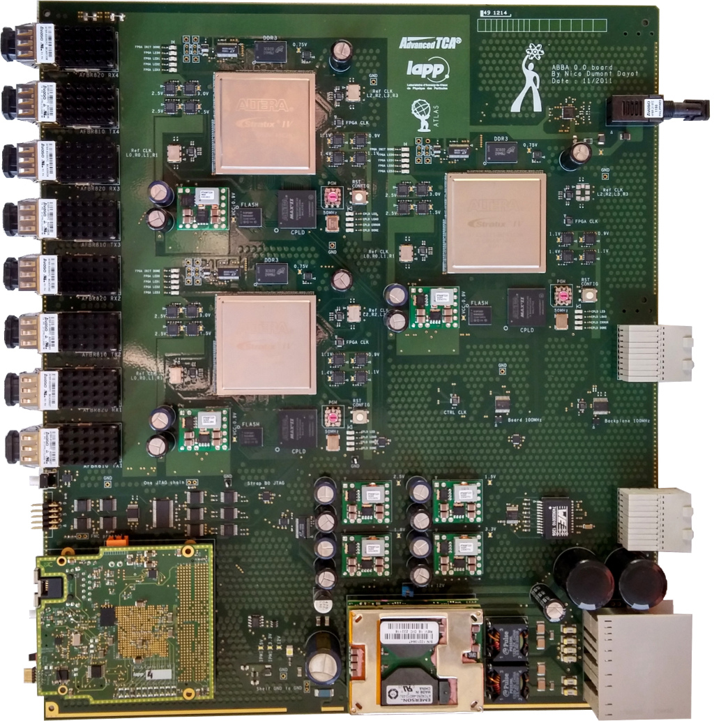
BE Demonstrator: ABBA
ATCA board: 3 Altera FPGAs (StratixIV)
Receives up to 320 Super Cells signals (SC) from one LTDB
48 optical links @ 4.8Gbps
Stores Super Cells data into circular buffer
Latency up to 2.5us
Waits for TTC trigger to readout Super Cells
Readout with filtered Level-1 trigger
Readout through 10GbE Ethernet network
Readout with ATCA fabric interface
Status:
3 ABBA boards installed
Online software has been set
Taking collision data in LHC Run 2
Performance as expected

Slide 29
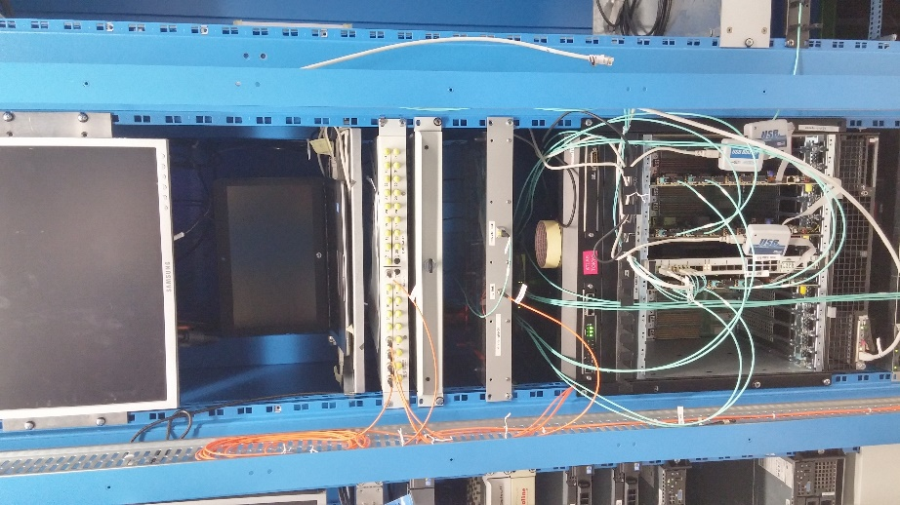
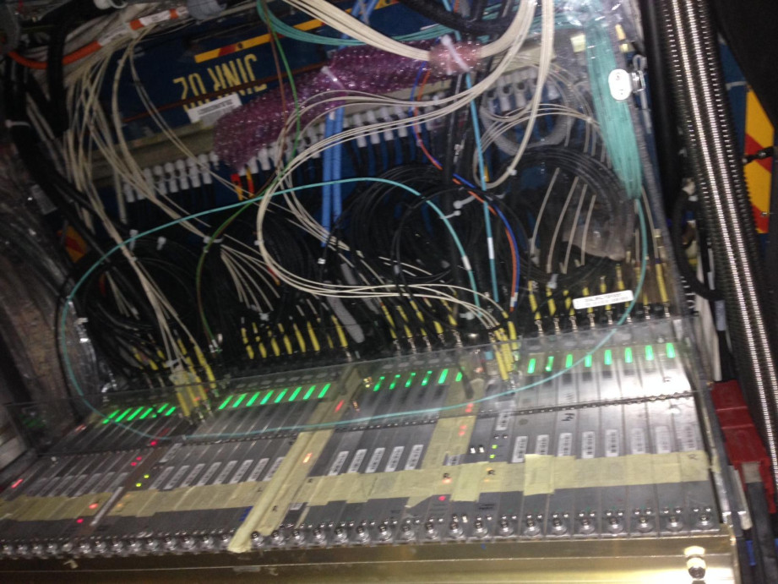
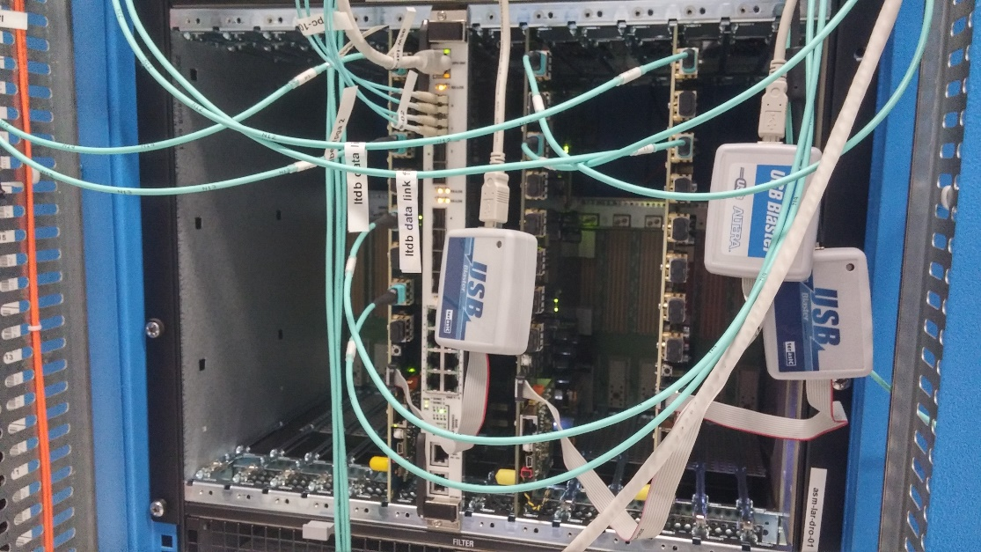
Demonstrator installation in ATLAS
LTDB
ABBAs in ATCA crate

Slide 30
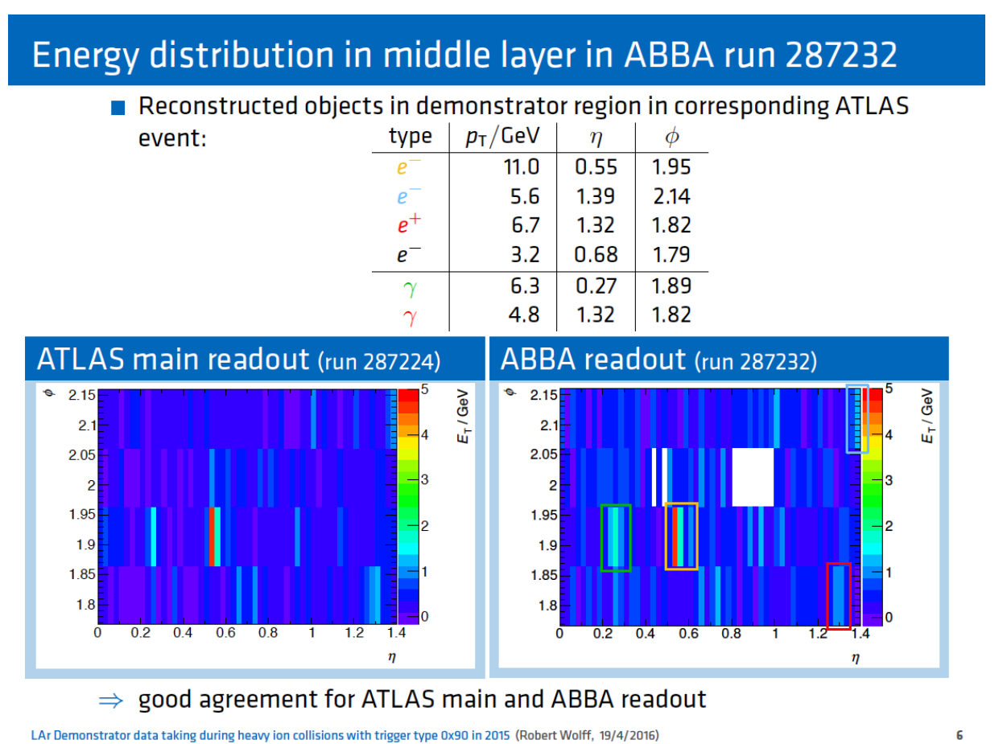
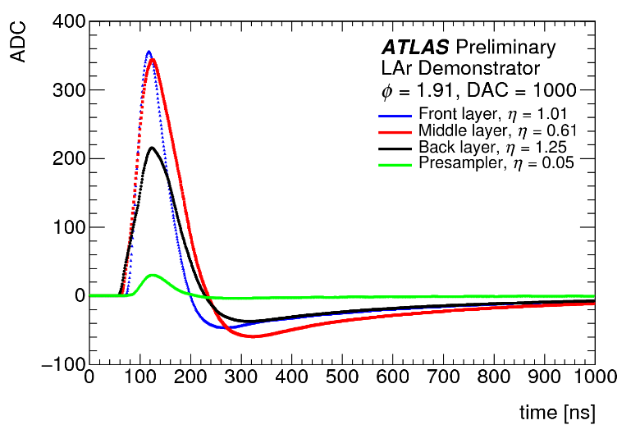
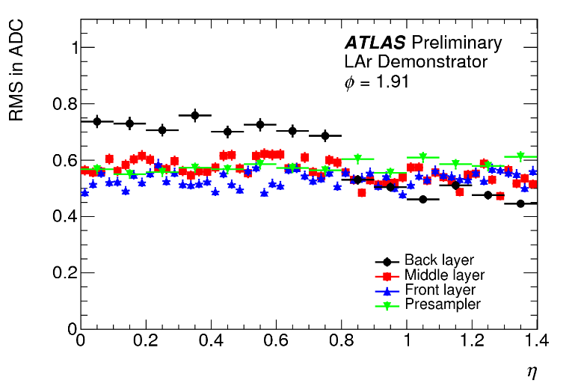
Demonstrator data taking
Calibration:
electronic pulses sent by calibration board
Collisions (proton-proton and heavy ion):
successful data taking in 2015 and 2016:
collected data triggered in Demonstrator region
special L1Topo trigger item used
compared Demonstrator readout and ATLAS main readout
Total noise on main readout of calorimeters cells of demonstrator (IO6) ~ neighboring crates
Plan for early 2018 to have final prototype installed and running in end of Run 2

Slide 31
Summary

Slide 32
Summary

Slide 33
Backup slides

Slide 34
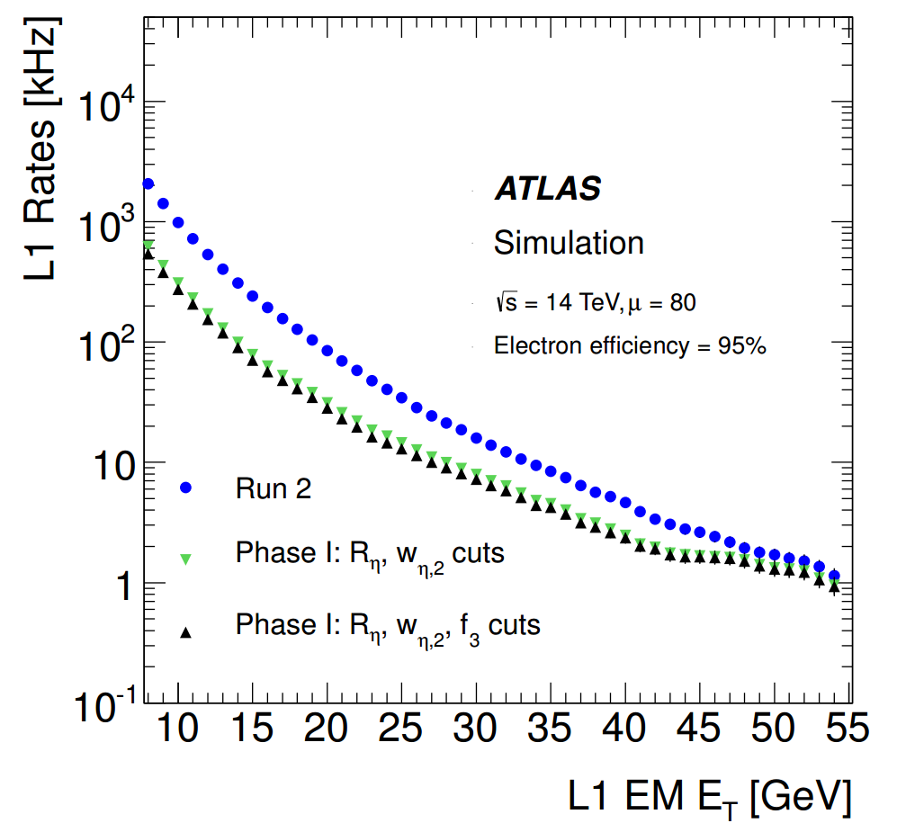

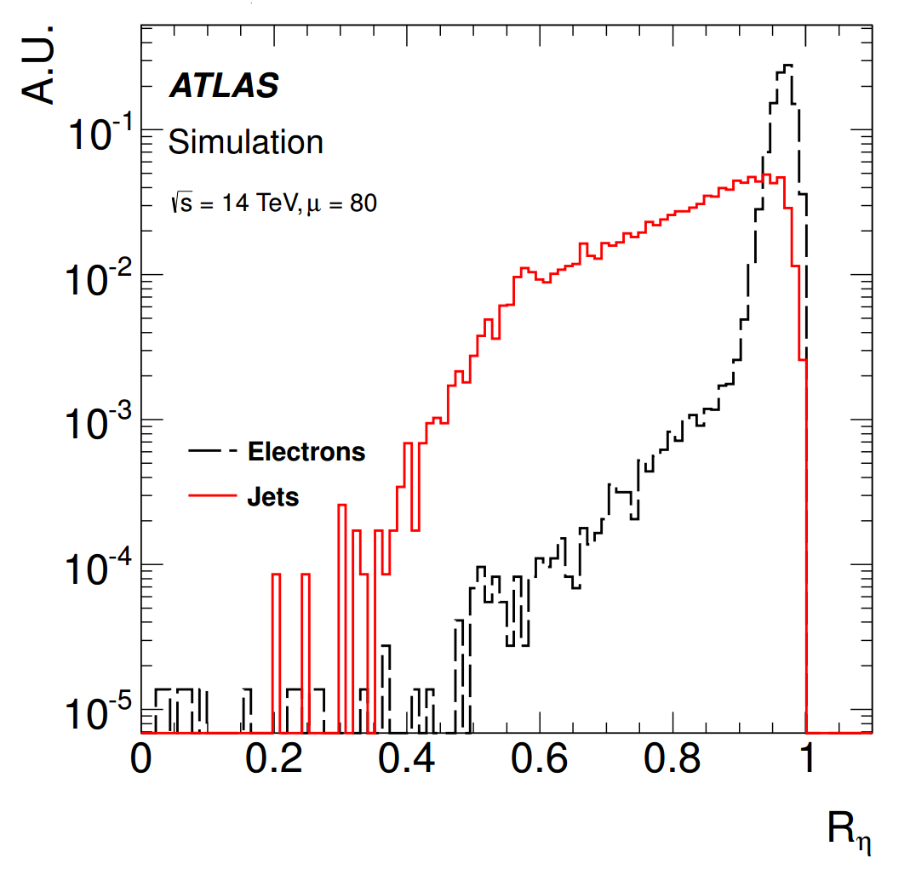
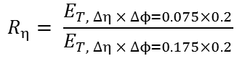
Motivation and strategy
Main goals: deal with the luminosity increase, maintaining a low-pT lepton threshold and keeping the same trigger bandwidth
With the new Phase-I electronics:
Make use of shower shape variables: a more sophisticated rejection of jet backgrounds
Level-1 threshold for a given bandwidth of e.g. 20 kHz (28.5 GeV assuming Run 2 conditions) could be lowered by 7 GeV
$$R_{η}= \frac{E_{T, ∆η × ∆ϕ=0.075×0.2}}{E_{T, ∆η × ∆ϕ=0.175×0.2}}$$
Ratio between the transverse energy of a Super Cells group of dimension 3x2 and the transverse energy of a group 7x2.
Ratio
2.5
~
ΔET
~
7 GeV

Slide 35
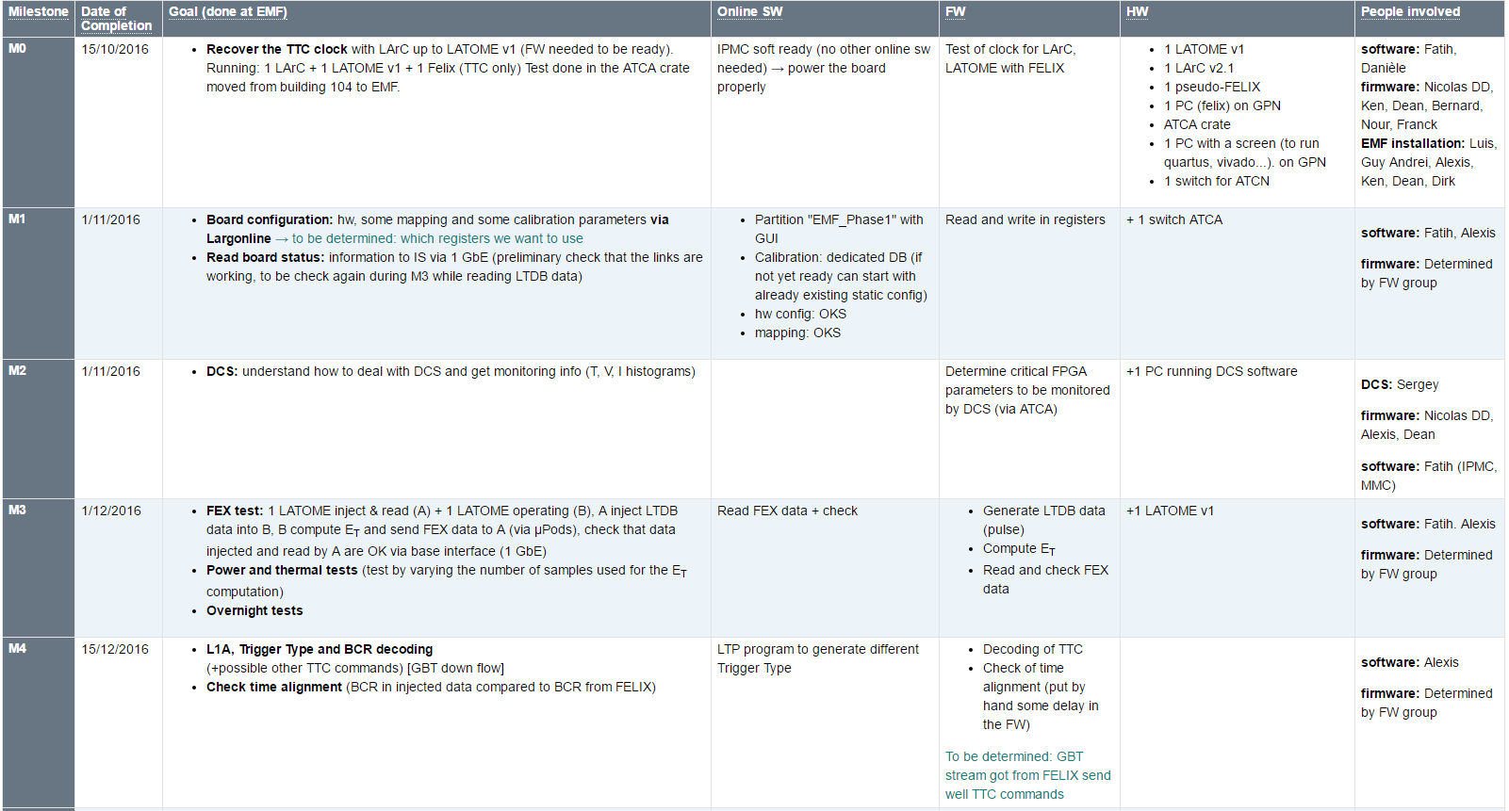
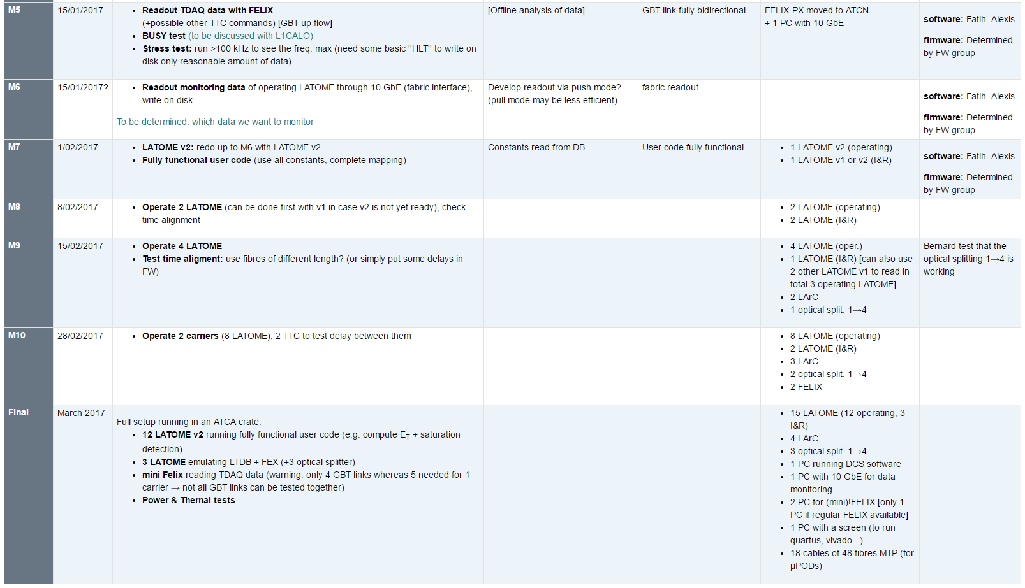
Back End System Test
ST-M0 completed on November 2016
Clock from FELIX well recovered on LArC and LATOME
ST-M1 had a slight delay, ~OK on January 2017
Good progress on firmware and software side to R&W in registers via 1GbE
DCS monitoring completed for ST-M2 on December 2016
ST-M3 will be the next major milestone: planned for March 2017
Inject LTDB data, and readout FEX data for comparison
ST-Mxx to M11: the last one to be completed ~Fall 2017

Slide 36
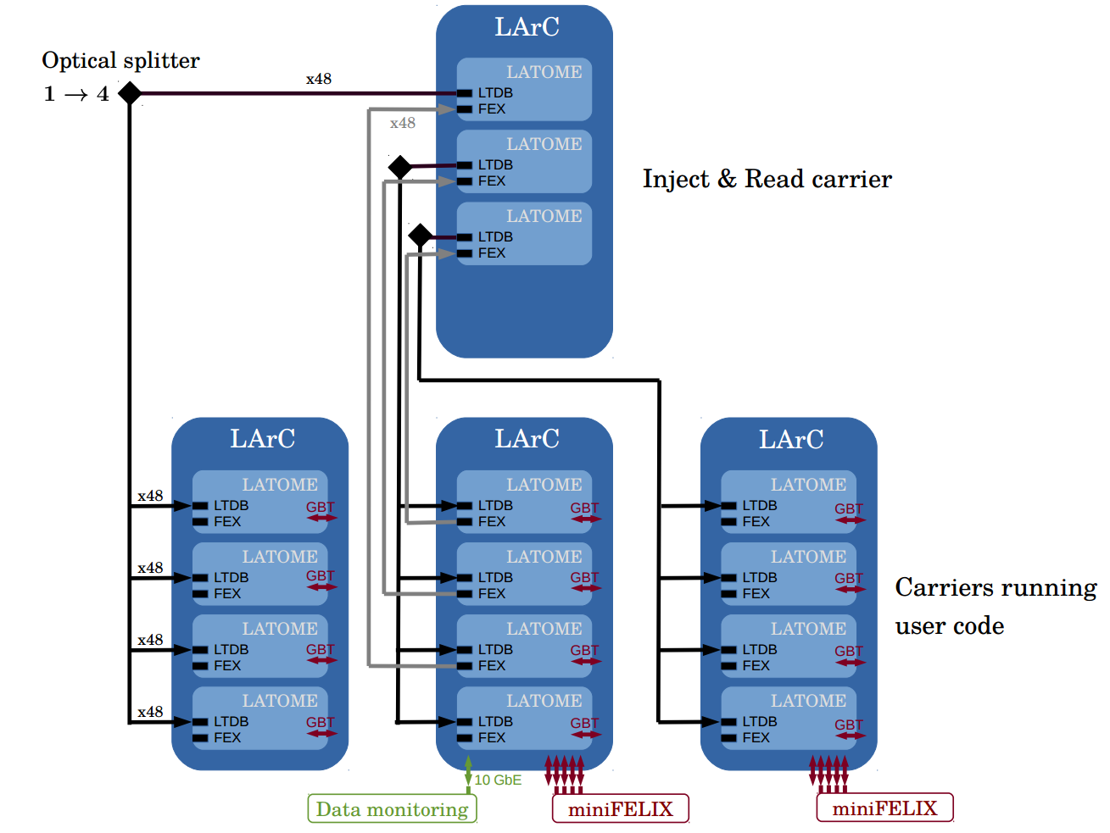
Test setup
1 carrier :
Inject « LTDB » data
Read « FEX » data
→ data verification
3 optical splitters 1→4 : feed the 3 other carriers
3 carriers running user code :
compute E_{T} for L1 (FEX)
Send data to TDAQ via FELIX
TTC signal via FELIX
Data Monitoring via 10 GbE
Test done at EMF

Slide 37
Number of boards
LTDB : 124
LAr Carrier : 31
LATOME : 124

Slide 38
Planning (1)

Slide 39
Planning(2)

Slide 40
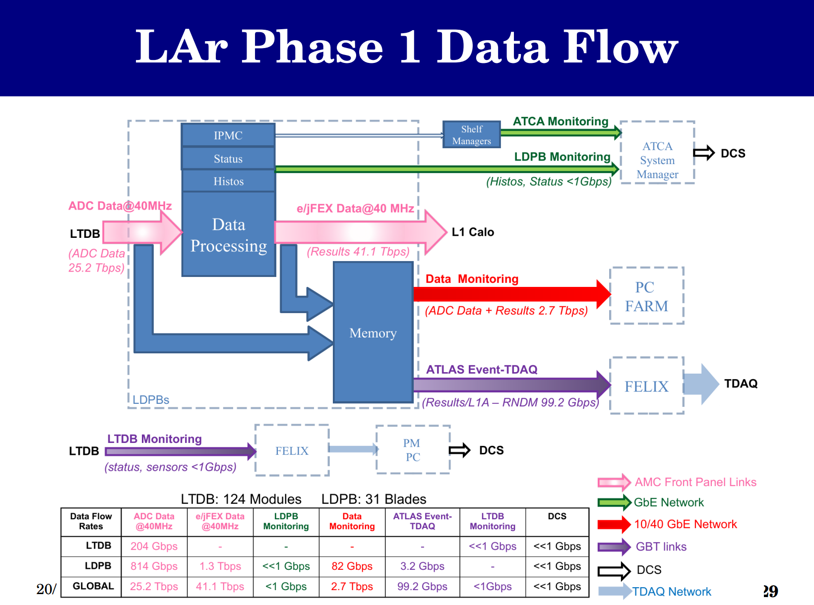
Phase-I Data Flow

Slide 41
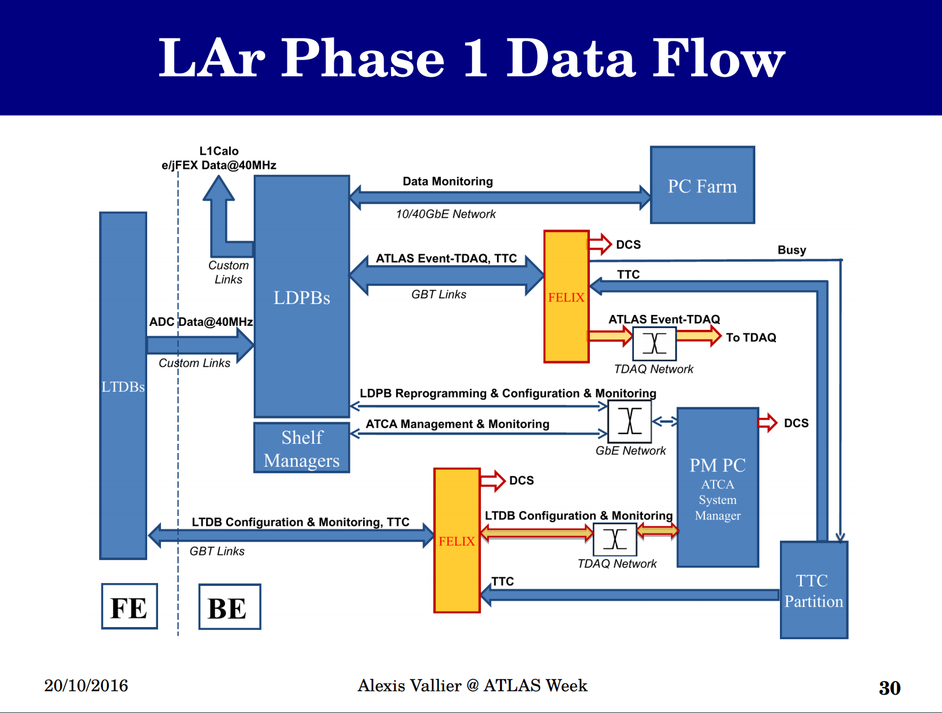
Phase-I Data Flow

